Slide 1


Self-gated self-supervised ADMM unrolling enables mesoscale high-resolution motion-robust diffusion-weighted imaging
Zhengguo Tan ¹, Patrick A Liebig ², Annika Hofmann ³, Michael Jaroszewicz ¹,
Yun Jiang ¹, Vikas Gulani ¹, Frederik B Laun ⁴, Florian Knoll ³
Michigan Institute for Imaging Technology and Translation (MIITT), Radiology, University of Michigan, Ann Arbor, Michigan, USA
Siemens Healthcare GmbH, Erlangen, Germany
Artificial Intelligence in Biomedical Engineering (AIBE), Friedrich-Alexander-Universität Erlangen-Nürnberg, Erlangen, Germany
Radiology, Universitätsklinikum Erlangen, Friedrich-Alexander-Universität Erlangen-Nürnberg, Erlangen, Germany

Slide 2
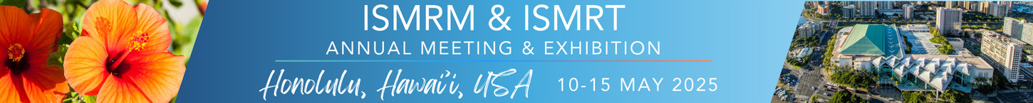
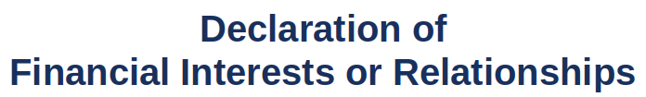
Z Tan:
I have no financial interests or relationships to disclose with regard to the subject matter of this presentation.

Slide 3
INTRODUCTION

Slide 4
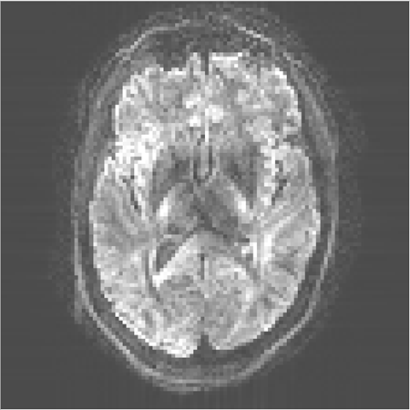
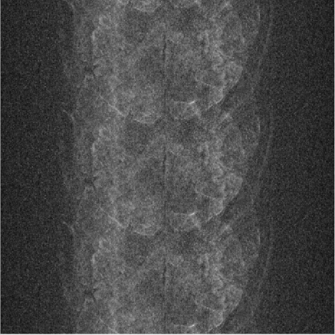
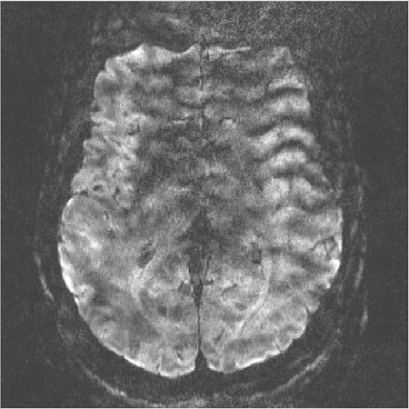
Diffusion-Weighted Imaging (DWI) ¹
Powerful tool for acute stroke diagnosis, fiber tracking, cancer staging, …
Challenges:
Low spatial resolution
Shot-to-shot phase variation
Motion
1. Le Bihan D. From brownian motion to virtual biopsy: a historical perspective from 40 years of diffusion MRI. Jpn J Raiol (2024).
Notes:
Have images that visualize challenges

Slide 5
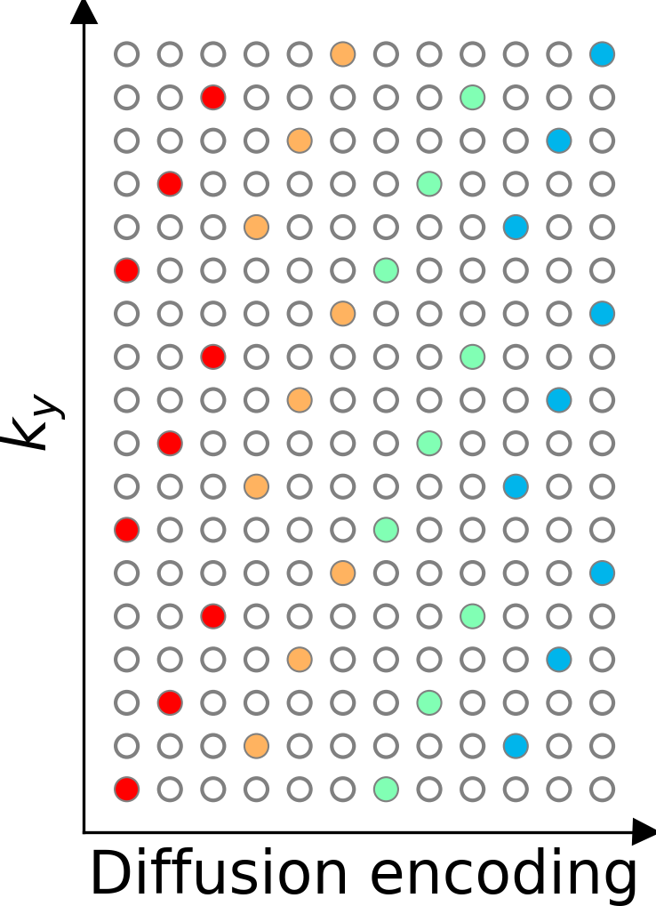
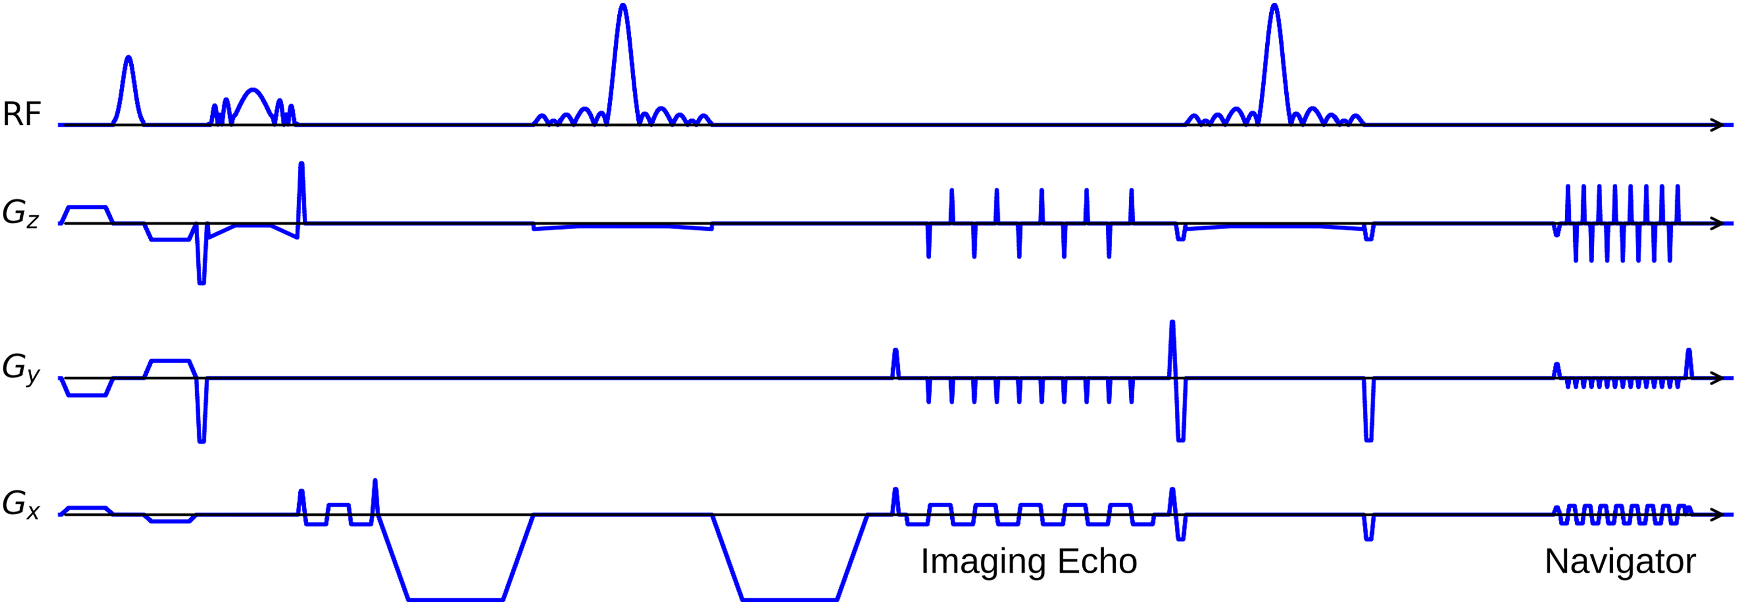
Previous Work: Mesoscale High-Resolution DWI Acquisition with NAViEPI ²
Brain DWI Protocol: 0.7 mm ISO
Shots: 3; Acceleration: 2 x 2; Matrix size: 286 x 286 x 176; 1 x b0 & 20 x b1000; TEs/TR: 58/98/15000 ms;
TA: 16 minutes.
TA reduced to 10 minutes w/o navigators.
Question: Selfgated reconstruction for accelerated DWI?
2. Tan Z, et al. JETS-NAViEPI. Imaging Neuroscience (2024).
Notes:
Make the research question big!
Color-code the two echoes
Enlarge the fontsize

Slide 6
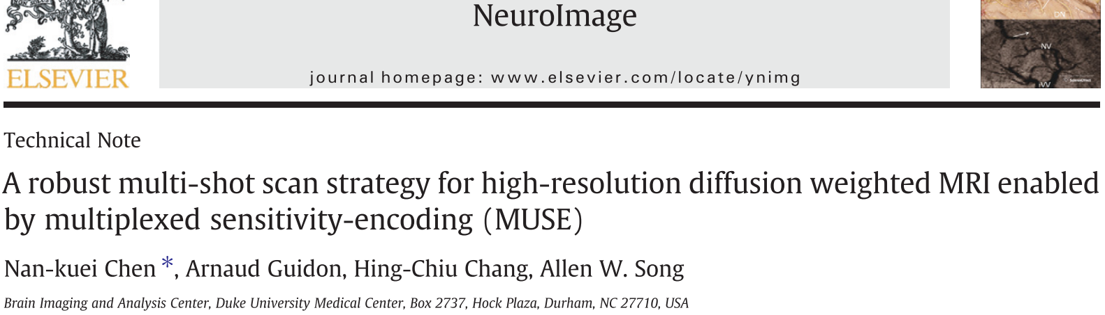
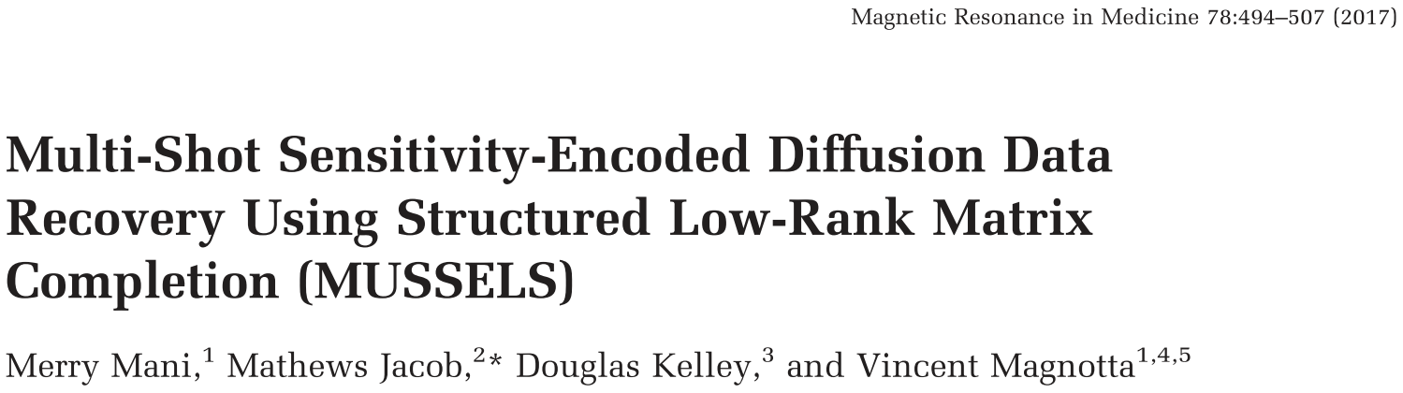
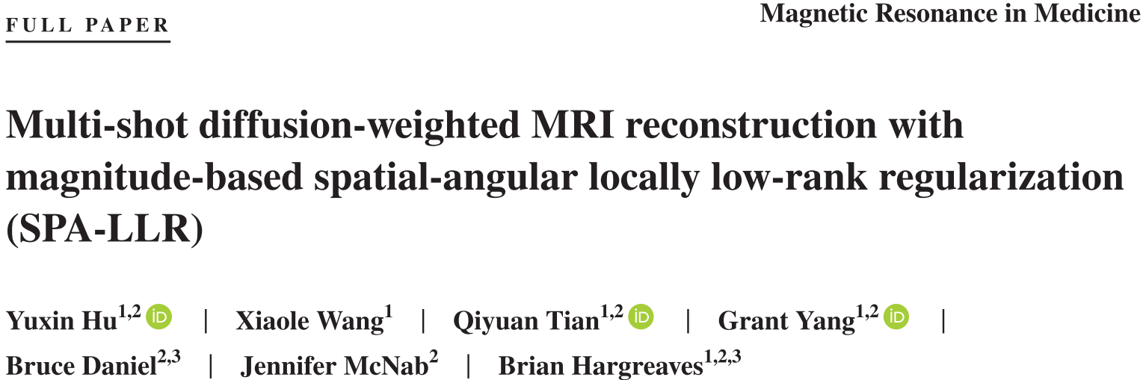
State-of-the-Art Selfgated DWI Reconstruction
MUltiplexed Sensitivity-Encoding (MUSE): simultaneous multi-slice (SMS) multi-shot SENSE
Low Rankness
> MUSSELS: low-rankness among shots
> LLR: Locally low rank of spatial-diffusion matrices
Notes:
Use paper title pdf screenshots

Slide 7
Inspiration: Self2Self & Zero-Shot Learning
Self2Self ³
A denoising neural network can be learned from one single image.
Zero-shot learning ^{4,5}
The regularization in iterative reconstructions can be learned without full-sampled k-space data.
Question: Self-supervised learning for high-resolution joint DWI reconstruction?
3. Quan Y, et al. Self2Self with dropout: Learning self-supervised denoising from single image. CVPR (2020).
4. Yaman B, et al. Zero-shot self-supervised learning for MRI reconstruction. ICLR (2022).
5. Heydari A, et al. Joint MAPLE: Accelerated joint T1 and T2* mapping with scan specific self-supervised networks. Magn Reson Med (2024).
Notes:
This slide is too full
Say some key features of zero-shot learning
make the font size bigger

Slide 8
METHODS

Slide 9
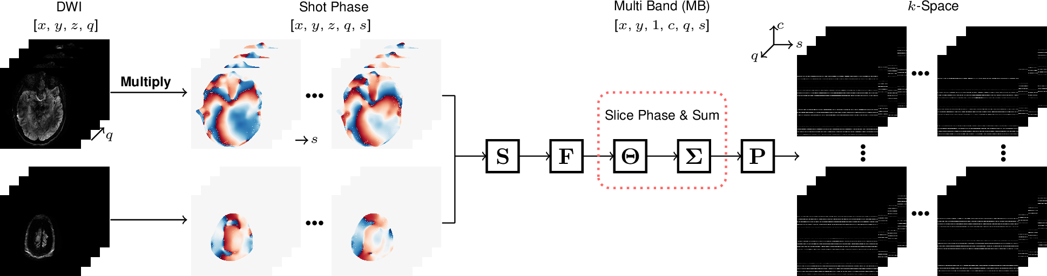
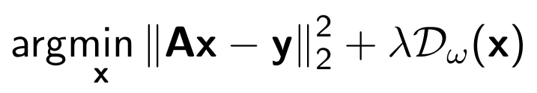
Joint k-q-Slice Reconstruction
Joint k-q-slice forward model (github.com/ZhengguoTan/NAViEPI)

Slide 10
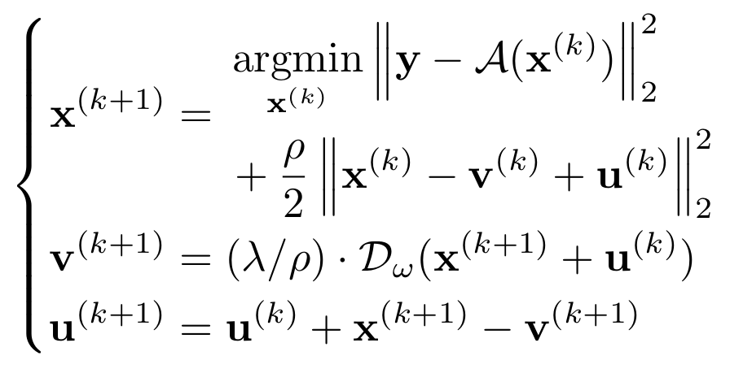
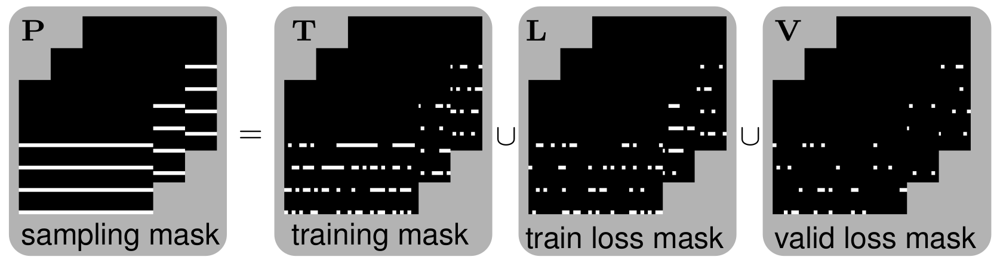
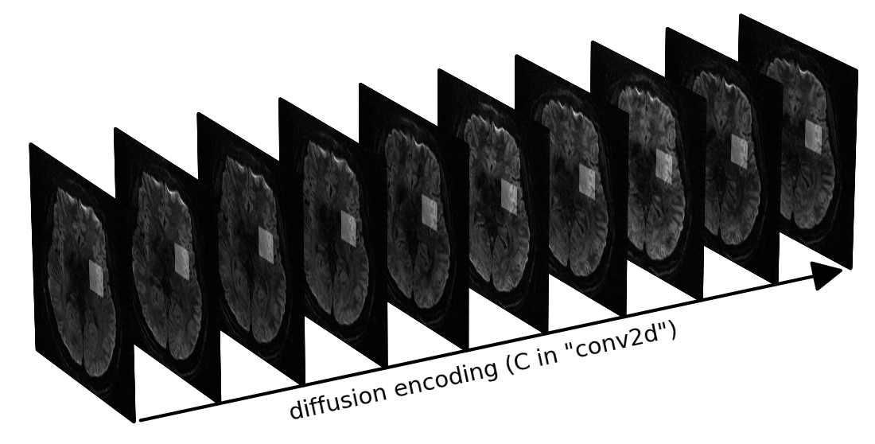
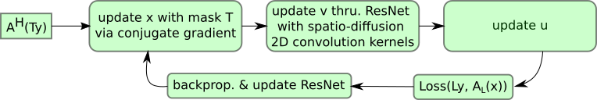
Self-Supervised ADMM Unrolling Reconstruction
(a) sampling mask splitting
(b) ADMM ⁶ unrolling
(c) training
(d) spatial-diffusion convolution
6. Boyd S, et al. Distributed optimization and statistical learning via the alternating direction method of multipliers. Found Trends Mach Learn (2010).
Notes:
C) enlarge fontsize

Slide 11
RESULTS

Slide 12
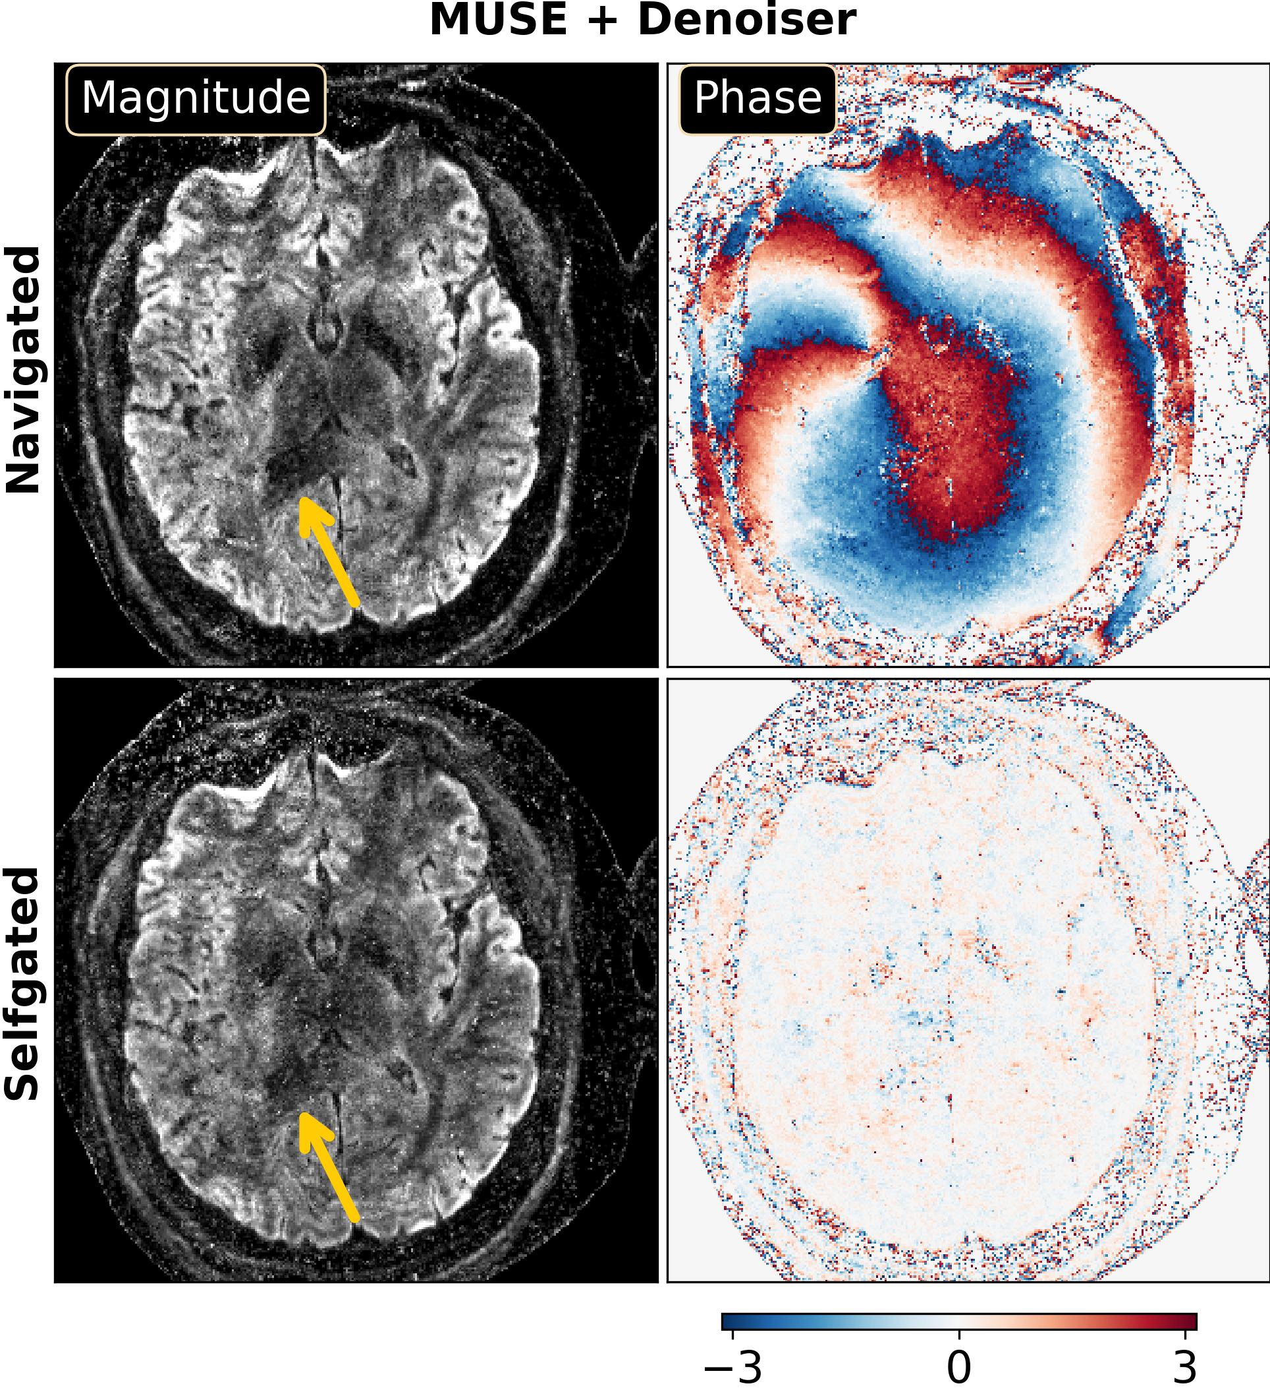
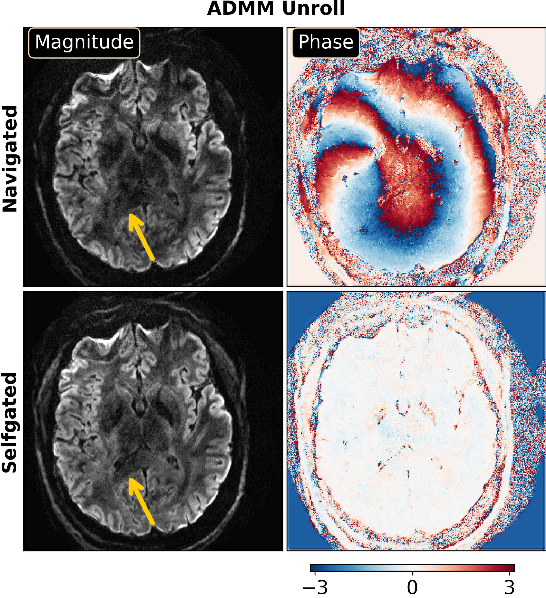
Joint k-q-Space ADMM Unroll Enables Selfgated DWI Reconstruction
Notes:
write dwon b-value 1000

Slide 13
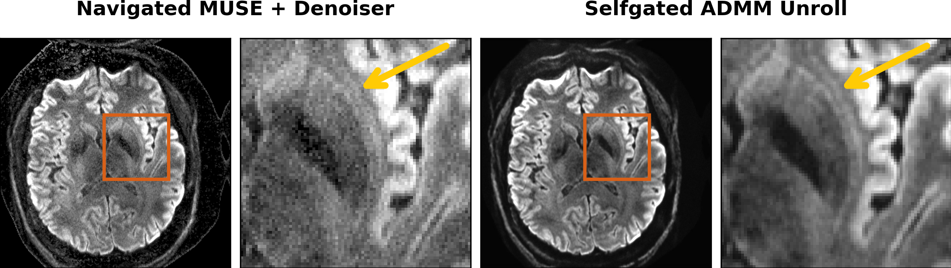
0.7 mm DWI Enables Visualization of the "Hidden-Away" Claustrum
Mean diffusion-weighted images from 20 directions at b = 1000 s/mm² are displayed

Slide 14
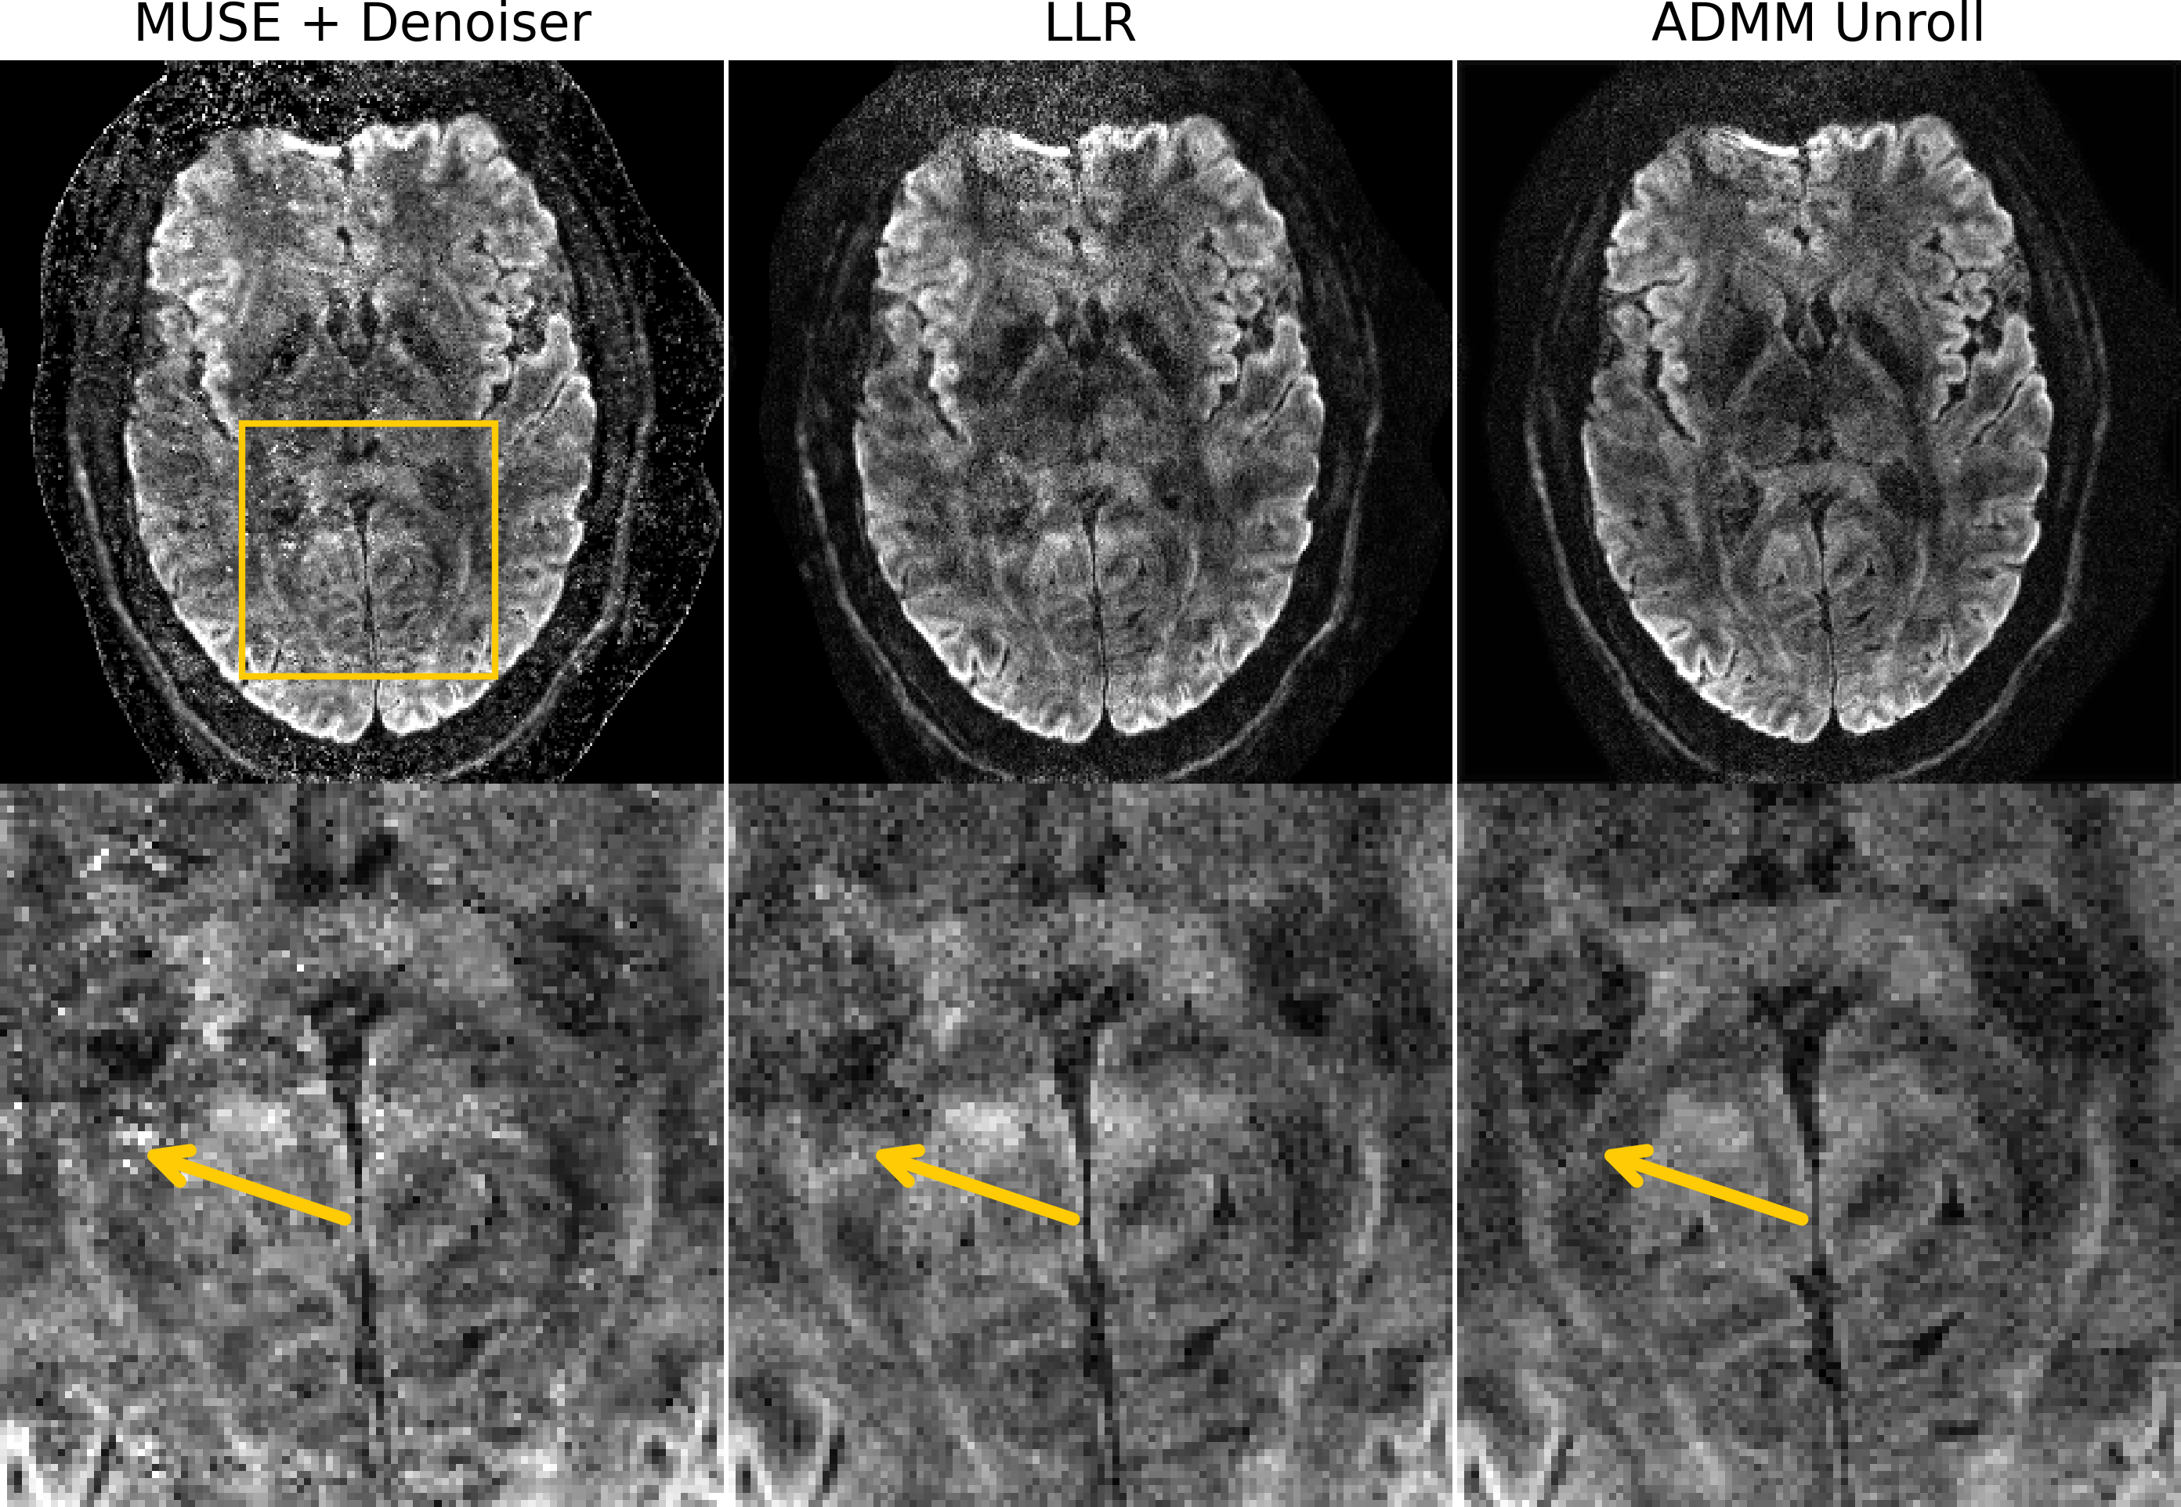
Joint k-q-Space ADMM Unroll Enables Selfgated DWI Reconstruction
0.7 mm ISO with 150 slices and 21 diffusion volumes with b = 1000 s/mm² at 10 minutes
Notes:
Show only the axial view

Slide 15
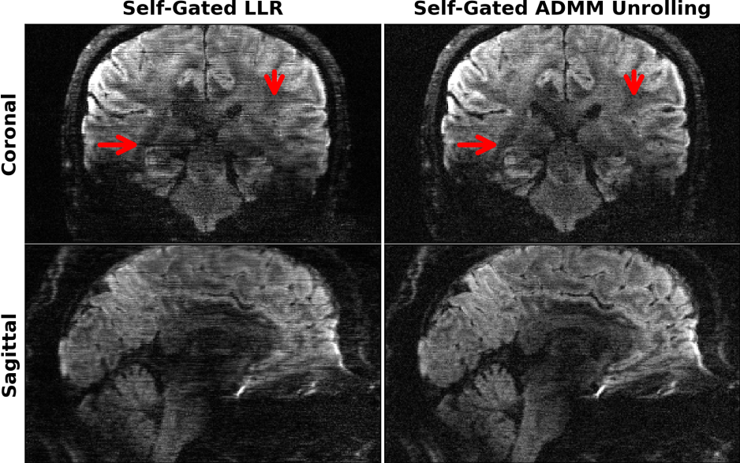
Motion Robustness

Slide 16
SUMMARY

Slide 17

Summary
Self-supervised ADMM unrolling enables mesoscale DWI at short scan time.
Notes:
Question --> answer
Add an image

